Slide 1
FTMS MANAGER
Group 11 :
Mary ann chev
Benjamin Willetts
Brent coutts
Rony azrak

Slide 2
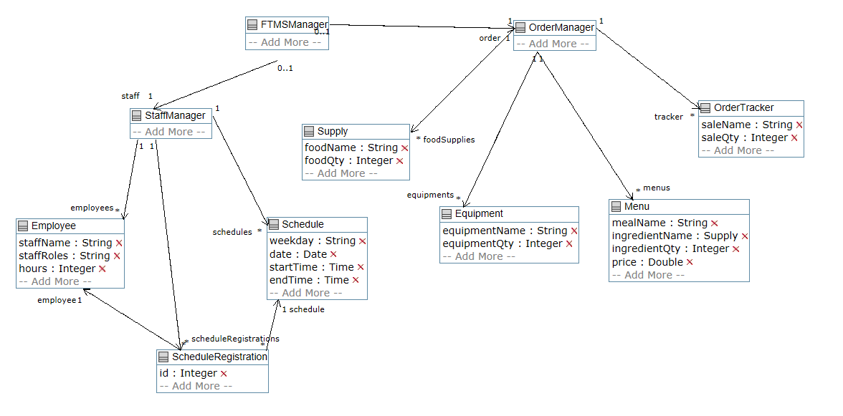
Domain model

Slide 3
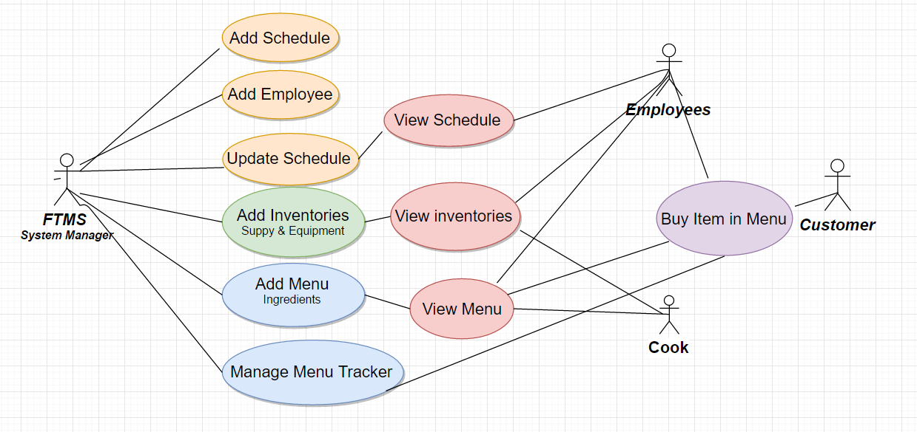
User diagram
Manager :
Edit schedule
Edit inventory
Edit menu
Generate reports on orders
Edit staff list
View staff list

Slide 4
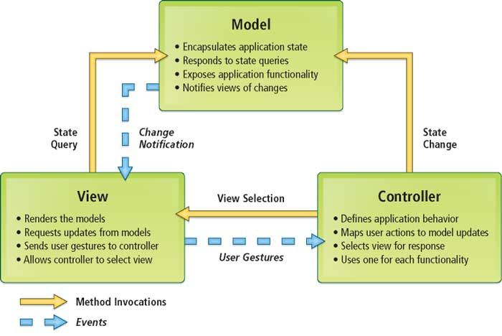
Design architecture (mvc type)
http://www.esri.com/news/arcuser/0609/graphics/aspnetmvc_1_lg.jpg

Slide 5
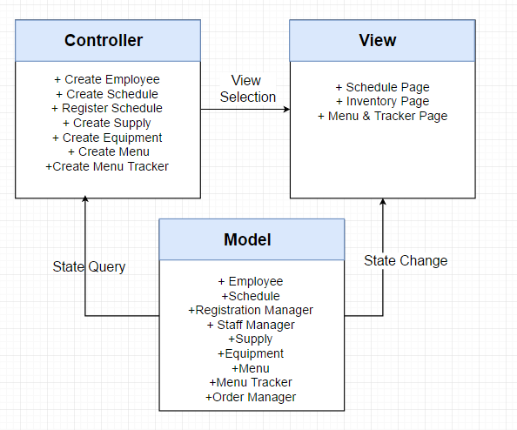
Project MVC architecture
Example of the FTMS Architecture

Slide 6
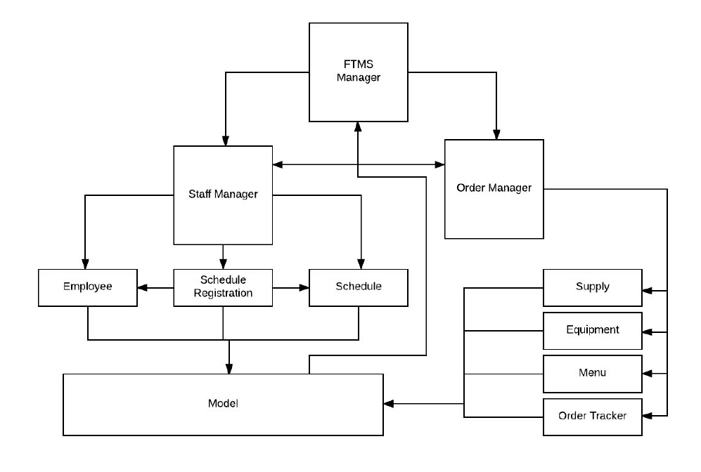
Architecture of the FTMS

Slide 7
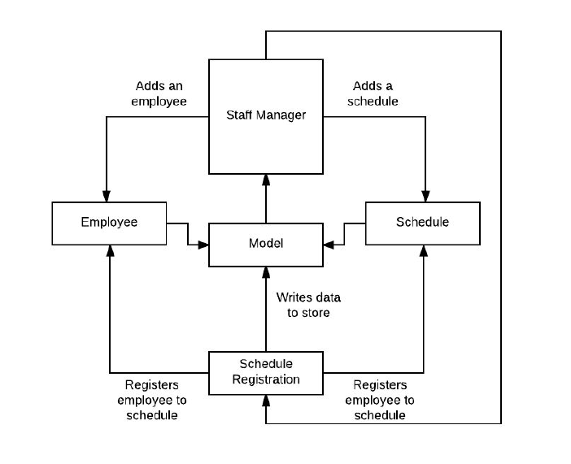
Architecture of the staff manager

Slide 8
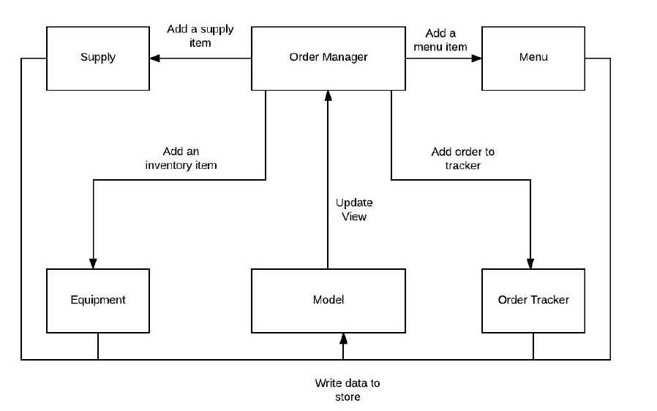
Architecture order manager

Slide 9

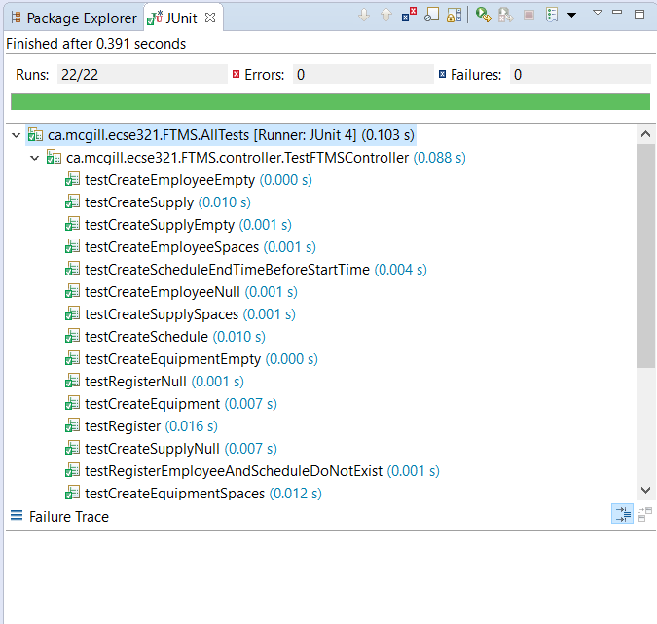
Quality Assurance : Unit & integration test:
Java : Junit test:
- Controller
- Persistence
Android: No unit test same as the JAVA portion
PHP: PHP unit Test
SYSTEM TESTING: -Manual system testing for all system

Slide 10
Release pipeline

Slide 11
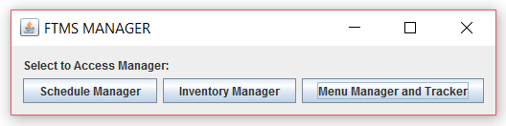
Desktop/laptop platform start-up view
All manager are implemented so that they have several views

Slide 12
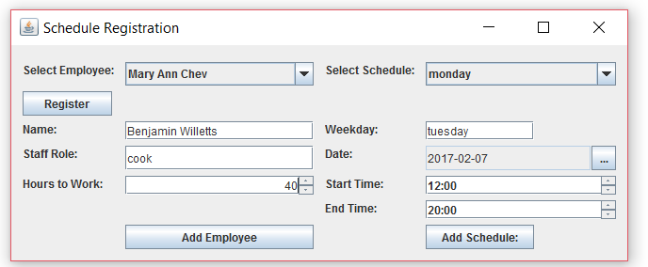
Desktop/laptop platform schedule manager view

Slide 13
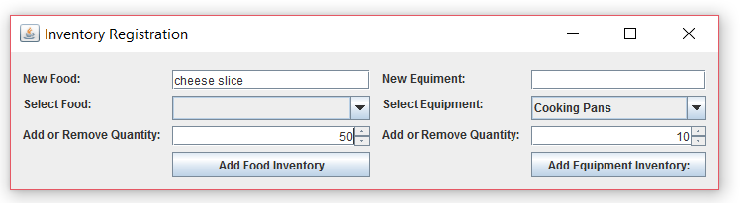
Desktop/laptop platform inventory manager view

Slide 14
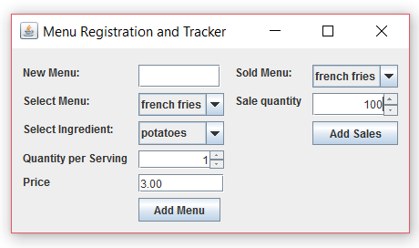
Desktop/laptop platform menu manager view

